Slide 1
GenTORE
Genomic management Tools to Optimise Resilience and Efficiency
WP5

Slide 2
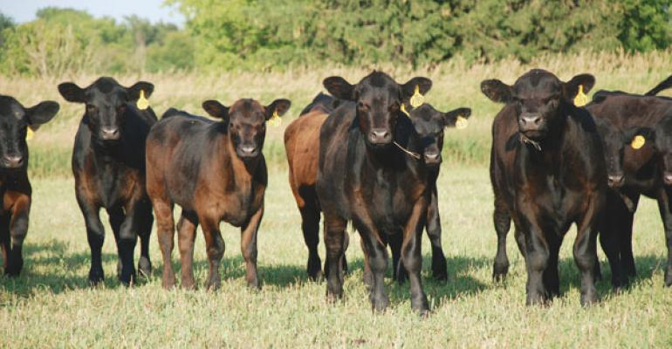
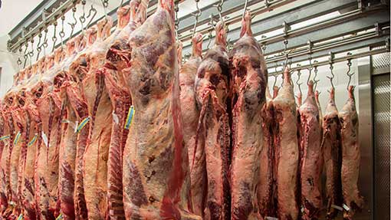
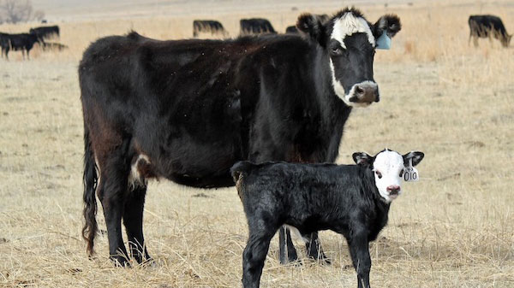
Beef decision support tools

Slide 3
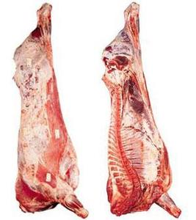
Beef’s Own Worth Motivation
Motivation
Which animal will make you the most money? How do you decide?

Slide 4
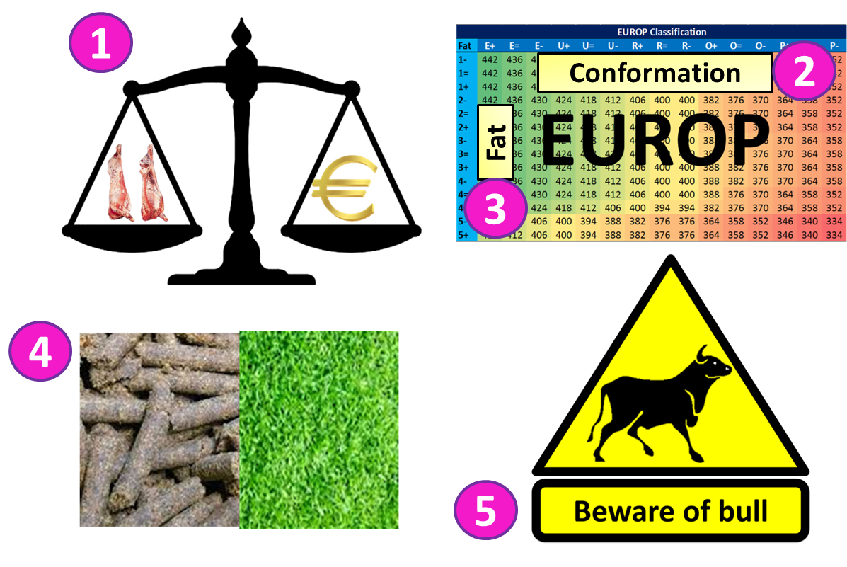
Beef’s Own Worth Objective
Objective: Develop a index that predicts the eventual carcass revenue

Slide 5
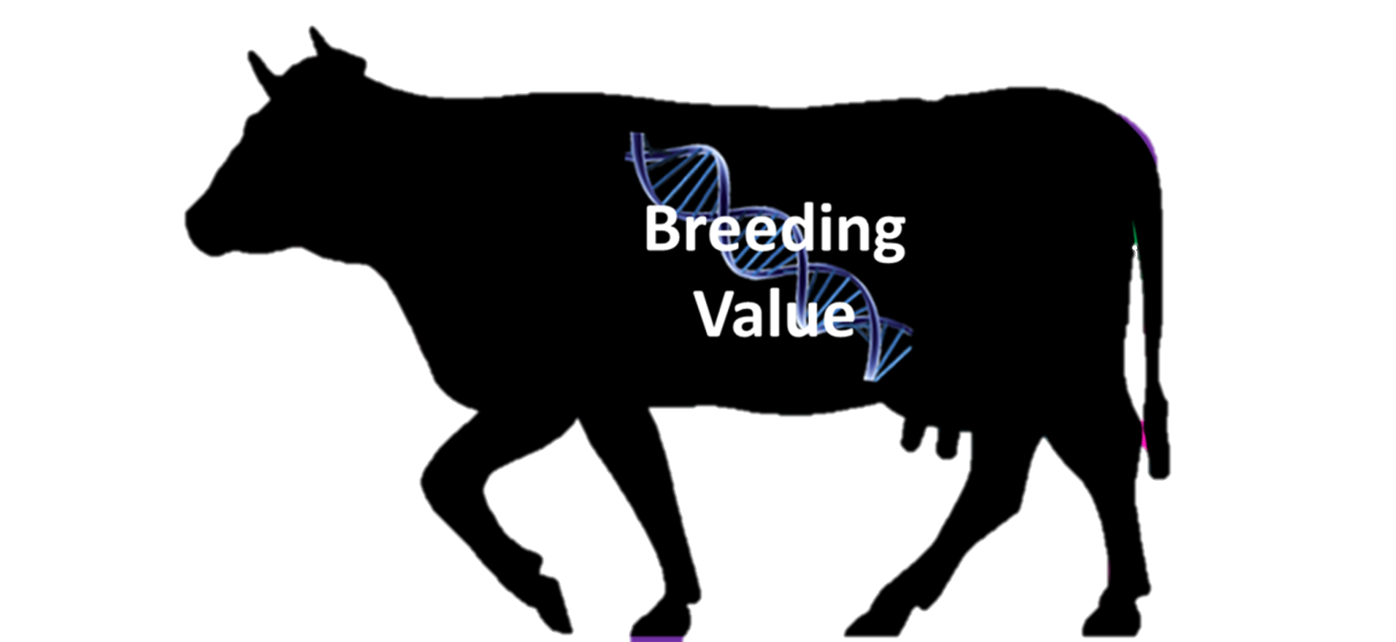
Beef’s Own Worth Index Estimation
Breed Effects
Breed

Slide 6
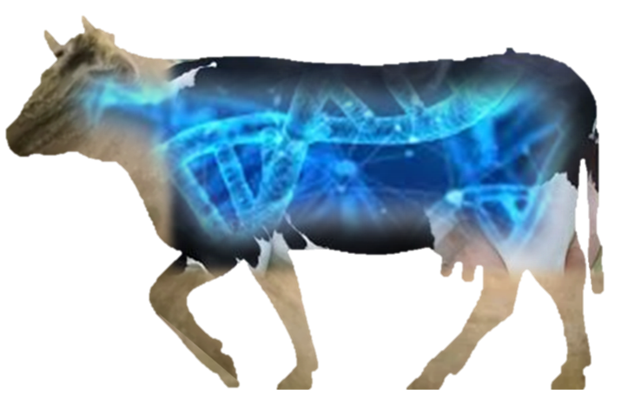
Beef’s Own Worth Index Estimation
Estimated Breeding Values

Slide 7
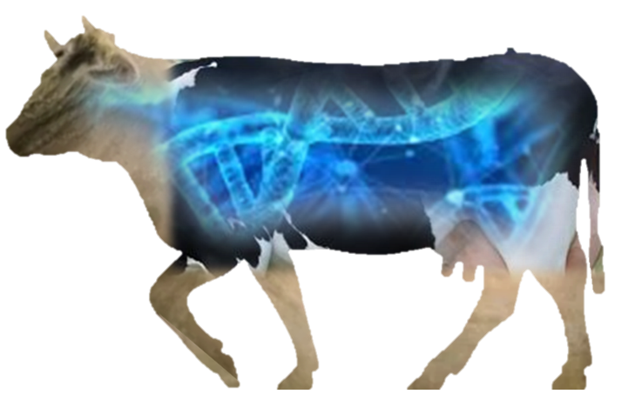
Beef’s Own Worth Index Estimation
Production Values
Twin
Gender

Slide 8
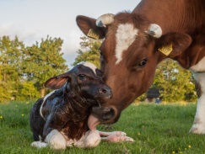
Beef’s Own Worth Results
National Terminal Index = To breed beef finishers
Validation Population
874 bulls and steers
Slaughtered 2016 – 2018
Data available:
Feed Intake records
Carcass information:
Carcass Weight
Carcass Conformation
Carcass Fat
€ Price/kg
Carcass Revenue
Index
Sub
-
components
Partial (n=874)
National
EBV
0.27
Terminal
Breed
0.20
B.O.W
EBV & Breed
0.36
PV
0.40

Slide 9
Beef decision support tools

Slide 10
Beef female’s Profit Potential Motivation
Motivation
Which animal will make you the most money? How do you decide?

Slide 11
Beef female’s Profit Potential Objective
Objective: Develop a index that predicts the lifetime profit potential of a beef female
Heifer Potential
Current Parity
Future Parity
Replacement Cost

Slide 12
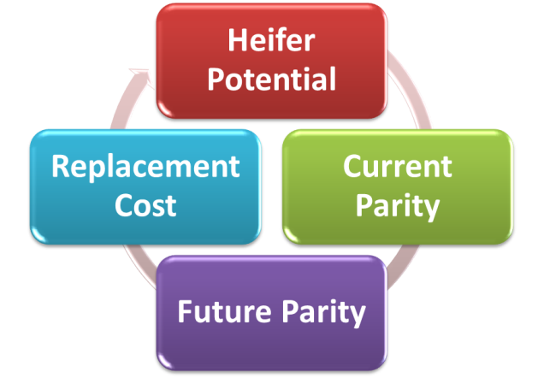
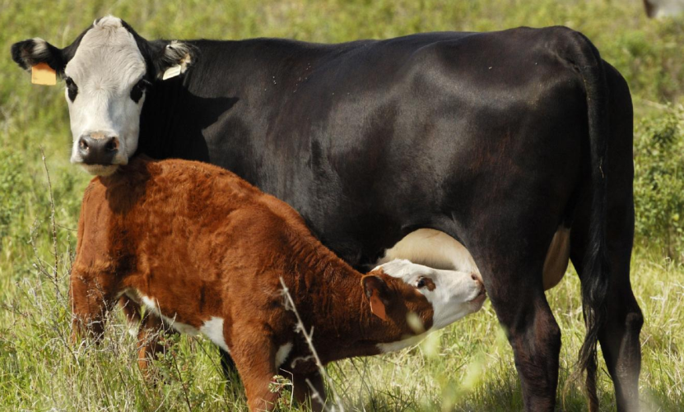
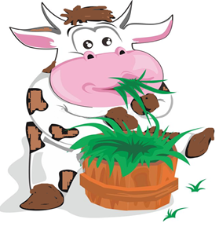
Beef female’s Profit Potential Index Estimation
Age at first calving
Live-weight

Slide 13
Beef female’s Profit Potential Index Estimation
|
|
| | |
|
|
| |
|
|
|
Live-weight
Progeny Traits (80%)
Docility
Replacement Index (20%)

Slide 14
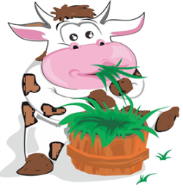
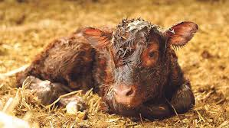
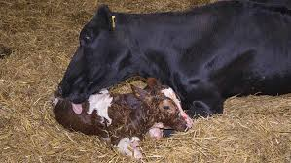
Beef female’s Profit Potential Index Estimation
Live-weight
Docility
|
|
| | |
|
|
| |
|
|
|
Progeny Traits (80%)
6
7
8
Calving Traits
Replacement Index (20%)
+ Predictions of Fertility and Survival

Slide 15
Beef female’s Profit Potential Index Estimation
Replacement Cost
Animal’s life left to Replace
$$×$$
$$−$$

Slide 16
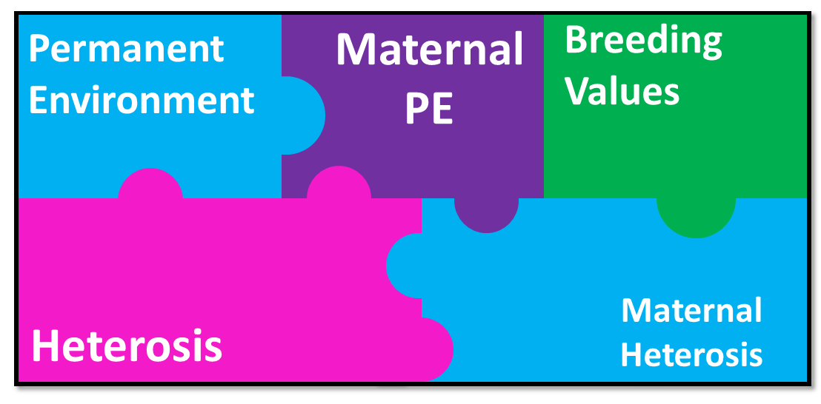
Beef female’s Profit Potential Index Estimation
Used various fixed and random effect solutions to estimate a beef female’s total merit for a given trait

Slide 17
Beef female’s Profit Potential
Currently working on validation

